Slide 1

CCLDAS HDF5 User Manual

Slide 2
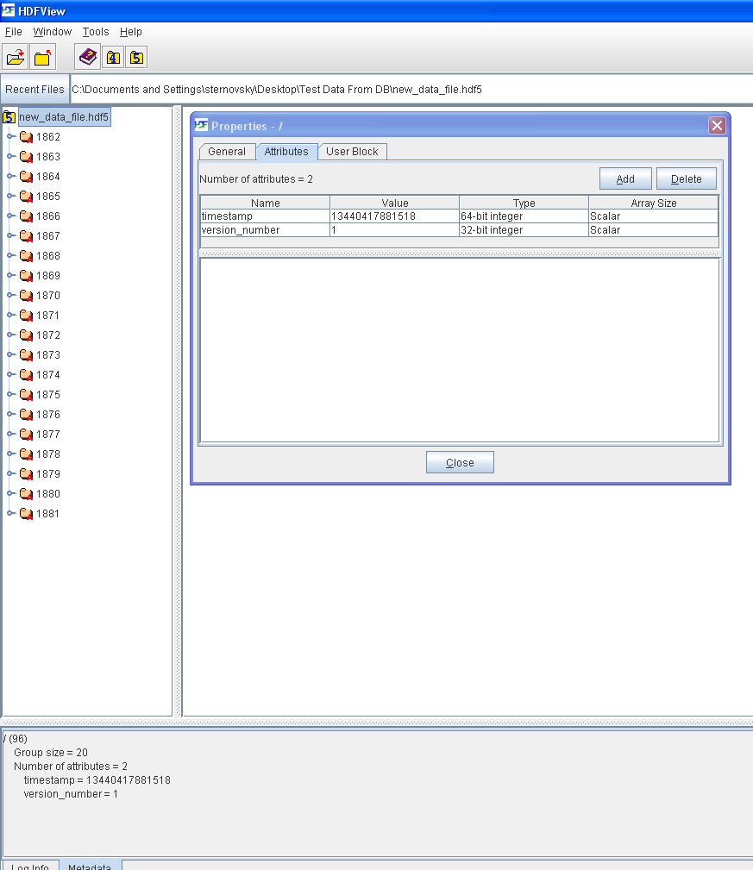
CCLDAS Format For .HDF5 Files
Each file is written with integer timestamp and version number attributes.

Slide 3
CCLDAS Format For .HDF5 Files
File attribute entries are:
“timestamp” a 64-bit integer
“version_number” a 32-bit integer

Slide 4
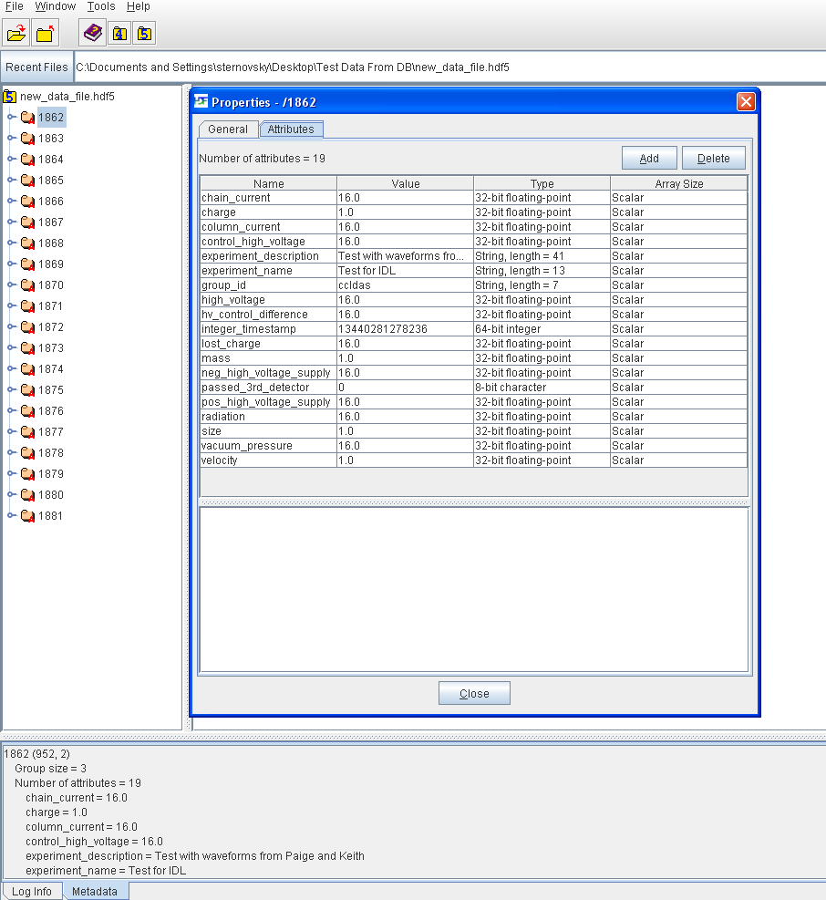
CCLDAS Format For .HDF5 Files
Dust events are stored as individual HDF5 groups. Shot metadata entries are saved as attributes for these dust event groups.

Slide 5
CCLDAS Format For .HDF5 Files
Group attribute entries are:
“chain_current” a 32-bit float
“charge” a 32-bit float
“column_current” a 32-bit float
“experiment_description” a string
“experiment_name” a string
“group_id” a string
“high_voltage” a 32-bit float
“hv_control_difference” a 32-bit float
“integer_timestamp” a 64-bit integer
“lost_charge” a 32-bit float
“mass” a 32-bit float
“neg_high_voltage_supply” a 32-bit float
“passed_3rd_detector” an 8 bit char
“pos_high_voltage_supply” a 32-bit float
“radiation” a 32-bit float
“size” a 32-bit float
“vacuum_pressure” a 32-bit float
“velocity” a 32-bit float

Slide 6
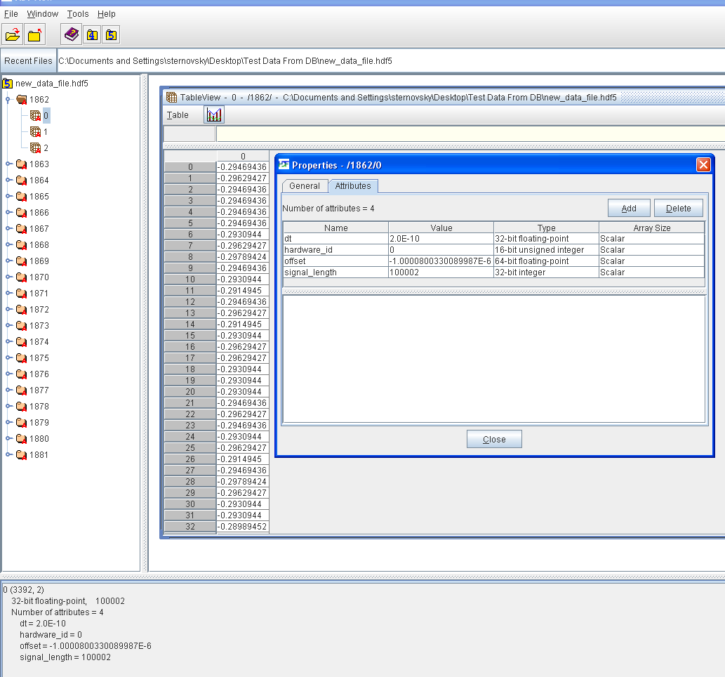
CCLDAS Format For .HDF5 Files
Raw data is stored as datasets in each dust event group, with signal metadata written as dataset attributes.

Slide 7
CCLDAS Format For .HDF5 Files
Dataset attribute entries are:
“dt” a 32-bit float
“hardware_id” a 16-bit integer
“offset” a 64-bit float
“signal_length” a 32-bit integer

